Slide 1
ARTICULATED Robots
PDE4431 Industrial Manipulators
Judhi Prasetyo & Bittu Scaria
Middlesex University Dubai

Slide 2
Articulated Robots
An articulated robot is a robot with rotary joints, typically with more than 4 axis. It uses these three revolute joints either in single/combination to access its work space. Usually the joints are arranged in a “chain”, so that one joint supports another further in the chain.

Slide 3
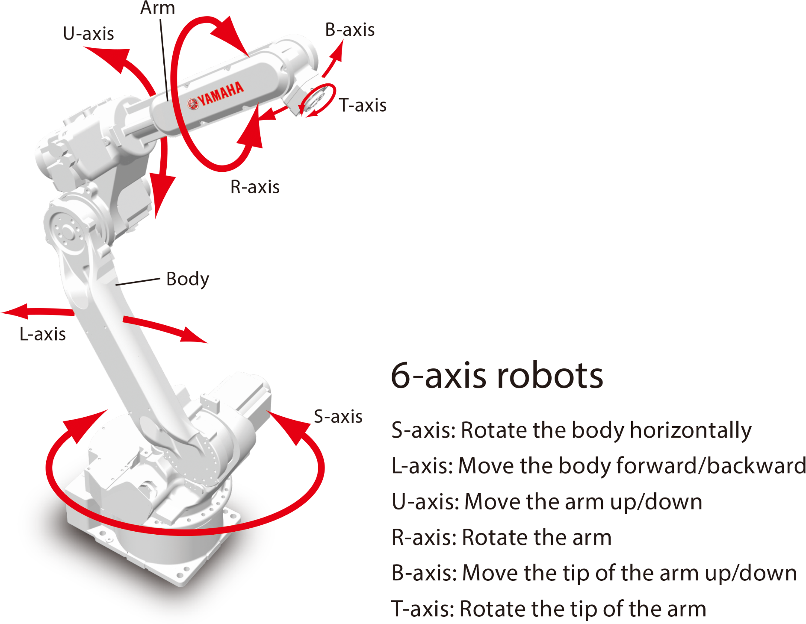

Slide 4
Features of Articulated Robots
The most common configuration is the articulated or jointed arm.
This closely resembles the human arm and is very flexible.
These are normally six axis machines, although some seven axis machines are available, providing redundancy and therefore improving access into awkward spaces.
The structure comprises six rotational joints, each mounted on the previous joint. They have the ability to reach a point, within the working envelope, in more than one configuration or position a tool in any orientation at a specific position.
Typical robot sizes range from a reach of 0.5 to over 3.5 m and carrying capacities from 3 to over 1000 kg.

Slide 5
The construction of the arm means each joint has to carry the weight of all the following joints; that is, joint three carries 4, 5,and 6. This impacts both the carrying capacity, the load that can be handled by the robot, as well as the repeatability and accuracy.
The structures are not particularly rigid and the overall repeatability is the cumulative of all of the axes.
60% of annual installations worldwide, although it is higher in Europe and the Americas (International Federation of Robotics, 2013).

Slide 6
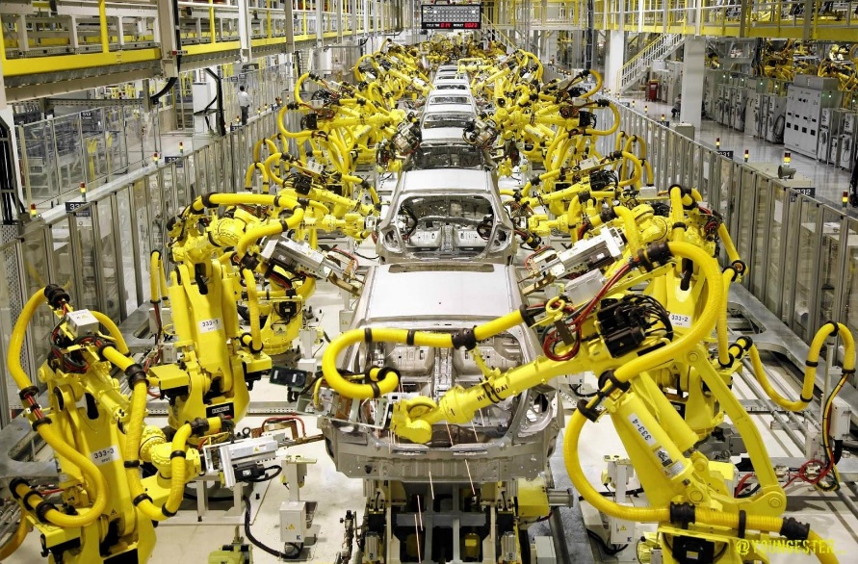
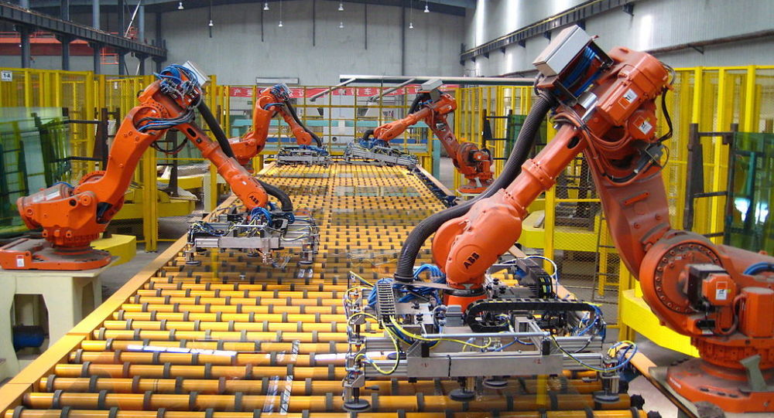
Application
This type of robot is used for many process applications, including welding and painting, as well as many handling applications including machine tool tending, metal casting, and general material handling.

Slide 7
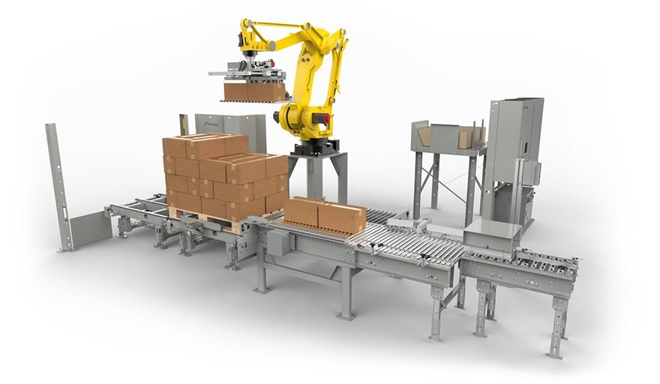
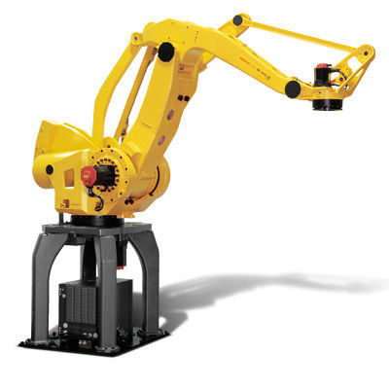
There are also a number of four axis articulated arms. These have been developed specifically for applications such as palletizing, packing, and picking where it is not necessary to orientate the tool. Therefore two of the wrist axes are not required. This type of robot is able to achieve higher speeds with higher payloads than the equivalent six axes machines.

Slide 8
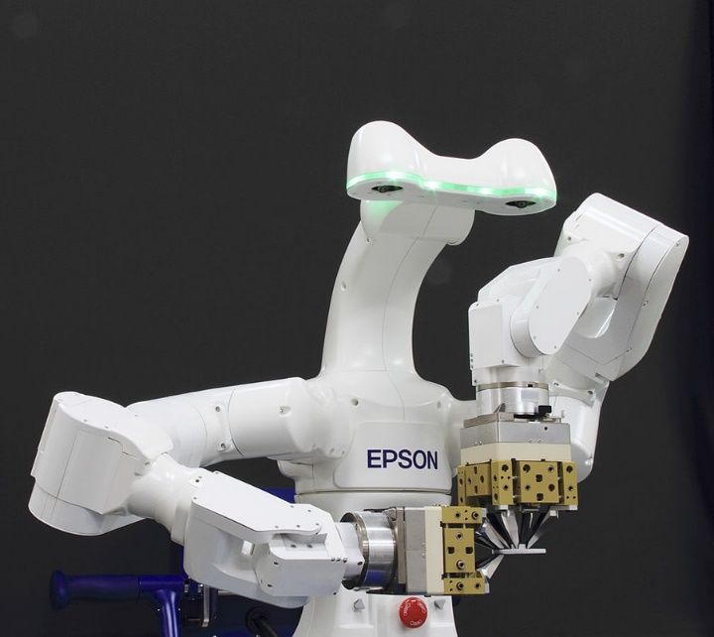
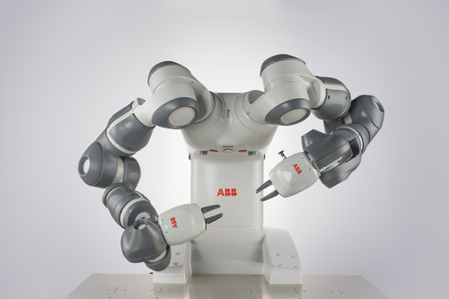
Dual Arm Articulated Robots
Dual arm robots, with two articulated arms mounted on the same structure, are also being developed. These two arms are able to work cooperatively and therefore mimic a human and are aimed at tasks such as assembly where two hands are required to work together to assemble the parts.

